Slide 1






DIGITAL DICE ROLLER SYSTEM DESIGN

Slide 2




INTRODUCTION
BRIEFLY INTRODUCE
The Digital Dice Roller is an electronic system that simulates rolling a die. It uses a microcontroller to generate random numbers (1-6) and displays the result. This project showcases the application of digital electronics principles.

Slide 3

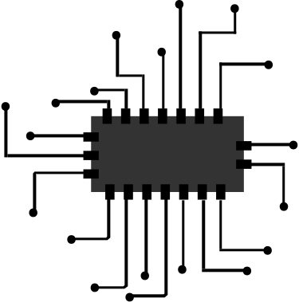

COMPONENTS
555 Timer IC
CD4017 Decade Counter
4511 Display Driver
7-Segment Display
Logic Gates (AND, OR, NOT)
Push Button
Resistors and Capacitors
Power Supply (5V)

Slide 4



METHODOLOGY
> CLOCK GENERATION:
A 555 TIMER GENERATES A CLOCK SIGNAL.
> COUNTING:
A CD4017 DECADE COUNTER CYCLES THROUGH ITS OUTPUTS USING THE CLOCK SIGNAL.
> DECODING & RANGE LIMITING: LOGIC GATES RESET THE COUNTER AFTER THE 6TH OUTPUT, ENSURING ONLY NUMBERS 1-6 ARE GENERATED.
> DISPLAY:
A 4511 DRIVER CONVERTS THE COUNTER'S OUTPUT TO SIGNALS FOR A 7-SEGMENT DISPLAY.
>RANDOMIZATION:
A PUSH BUTTON INTRODUCES VARIABILITY BY CONTROLLING THE CLOCK SIGNAL'S INFLUENCE ON THE COUNTER.

Slide 5



FLOW CHART
GENERATE CLOCK PULSES USING THE 555 TIMER
SEQUENTIALLY ACTIVATE OUTPUTS WITH THE CD4017 COUNTER.
FILTER INVALID OUTPUTS USING LOGIC GATES.
DISPLAY VALID OUTPUTS (1–6) ON THE 7-SEGMENT DISPLAY.
REPEAT
WAIT FOR THE NEXT BUTTON PRESS.

Slide 6



CONCLUSION
SUMMARIZE THE KEY POINTS
THE DIGITAL DICE ROLLER IS A RELIABLE, EFFICIENT ALTERNATIVE TO TRADITIONAL DICE. ITS SIMPLE DESIGN ENSURES FAIR AND RANDOM RESULTS, MAKING IT IDEAL FOR GAMING AND EDUCATIONAL USE. THE SYSTEM’S SCALABILITY AND ADAPTABILITY MAKE IT A VALUABLE TOOL FOR VARIOUS APPLICATIONS. FUTURE ENHANCEMENTS CAN EXPAND ITS FUNCTIONALITY AND APPEAL.

